Slide 1

Pet adoption: pre & post covid
BY: CAROLYN JOHNSON, JISU LEE, DILLON DOLEJSI AND NATHAN SKINNER
(PRESENTATION ORDER)

Slide 2
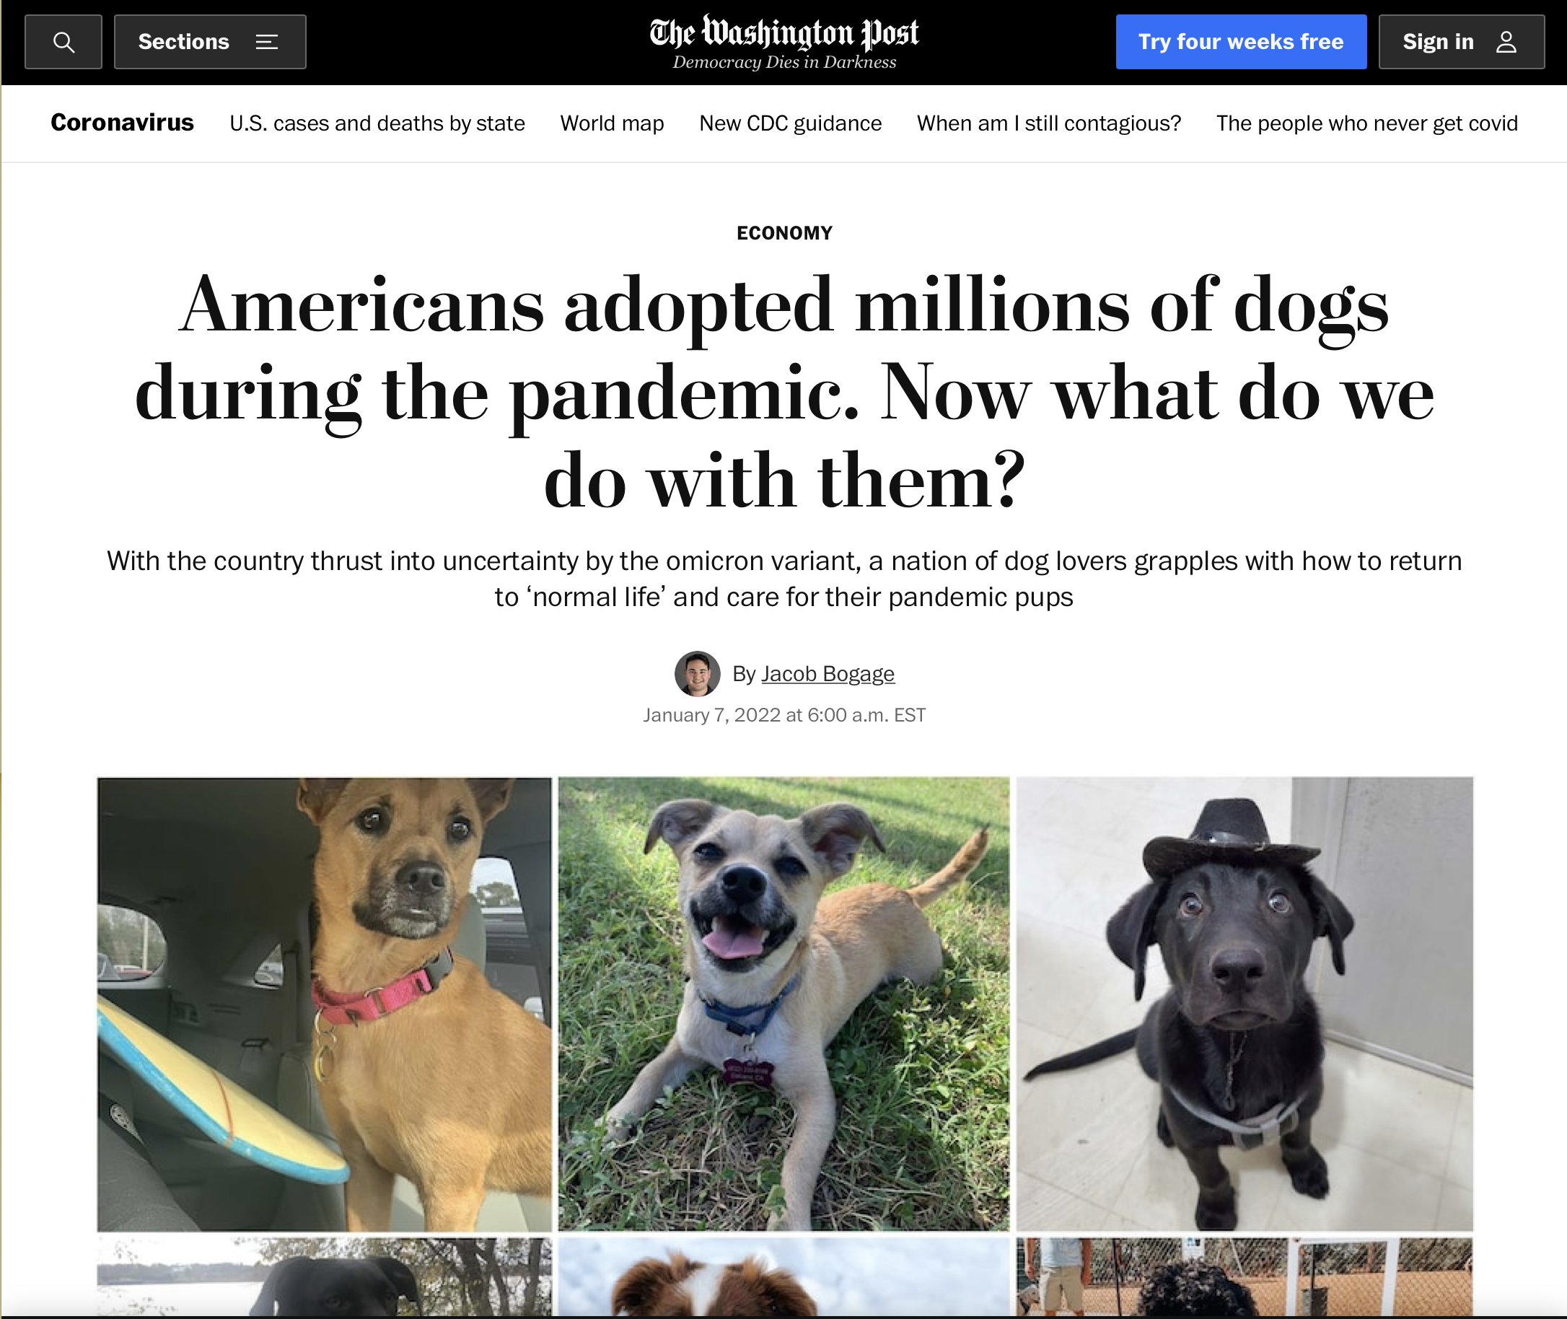
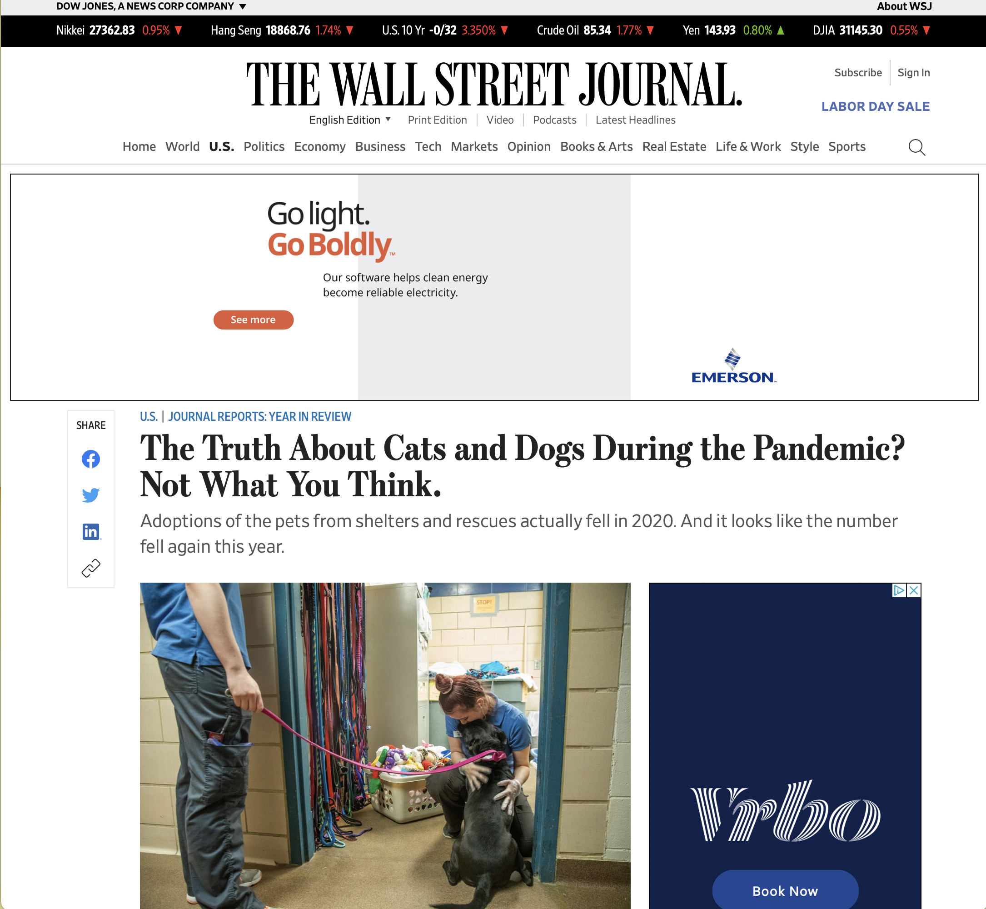
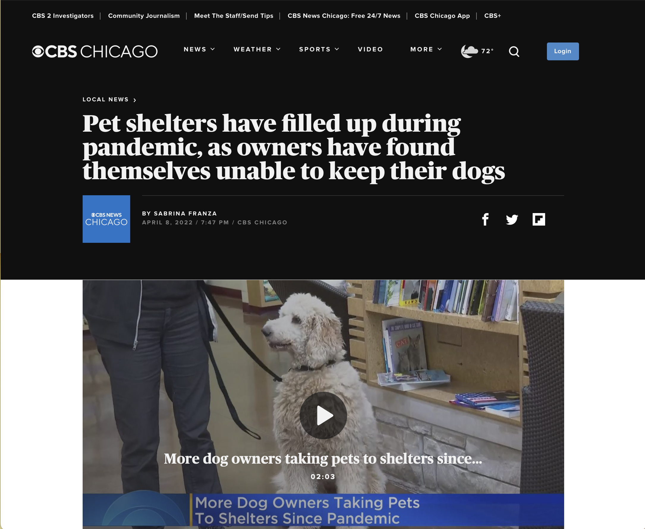
NEWS FEED:

Slide 3

Brief:
Anecdotal evidence suggests that lockdowns due to COVID-19 caused an increase in pet adoption.
We aim to use real data from Dallas County and Texas to determine if that was true.
We are also interested in the correlation between COVID-19 case numbers and adoption rates.

Slide 4

HYPOTHESIS:
Dog/Cat adoption rates went up when COVID cases increased due to people being at home more often.
Dog/Cat surrender rates went up as COVID cases decreased due to places opening and people having to go back to the office.

Slide 5
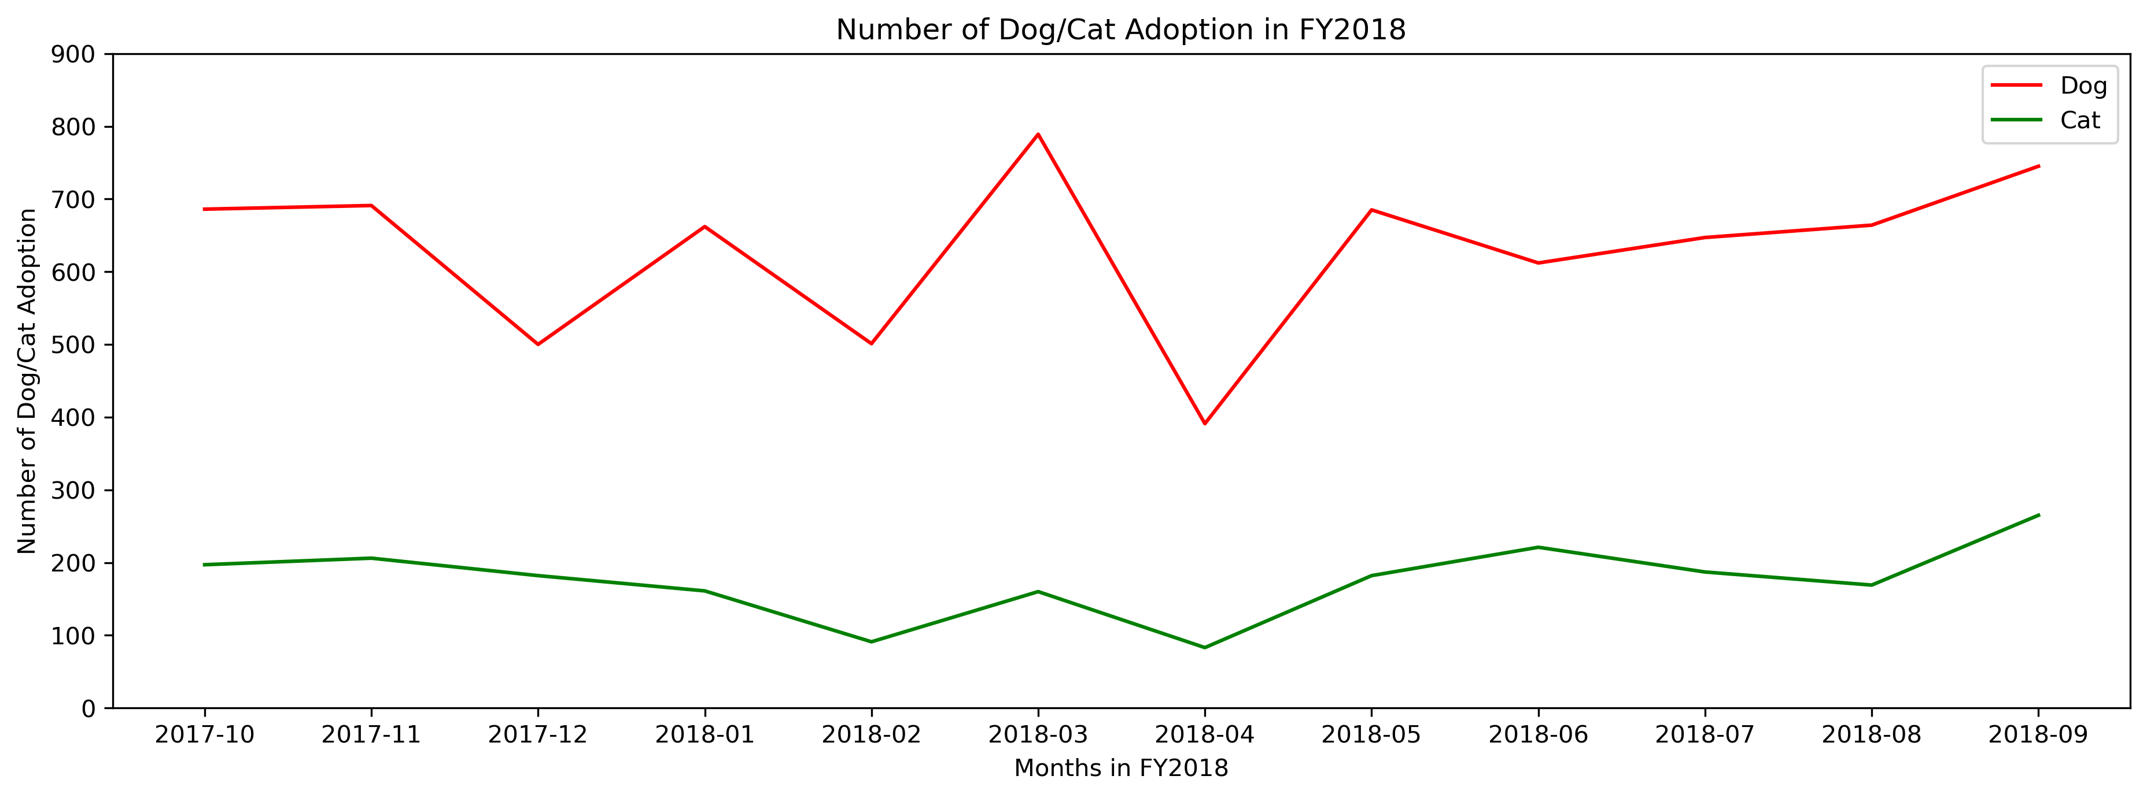
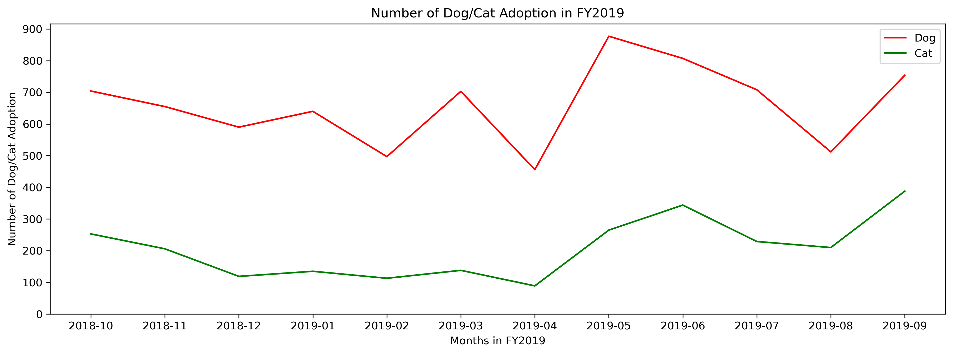
Adoption rates (Before)

Slide 6
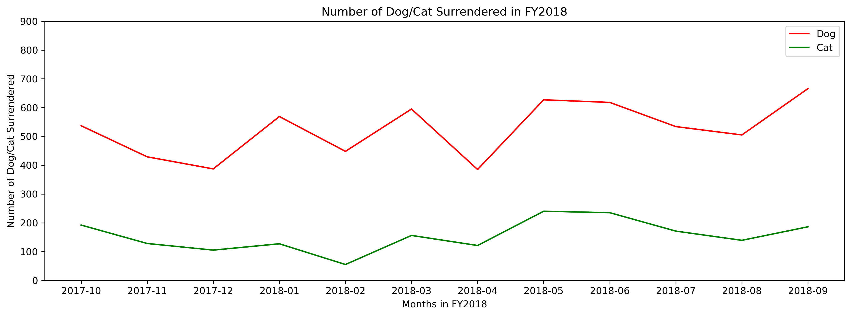
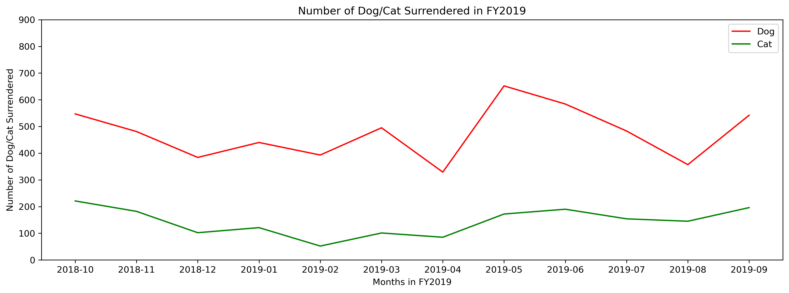
SURRENDER RATES (Before)

Slide 7
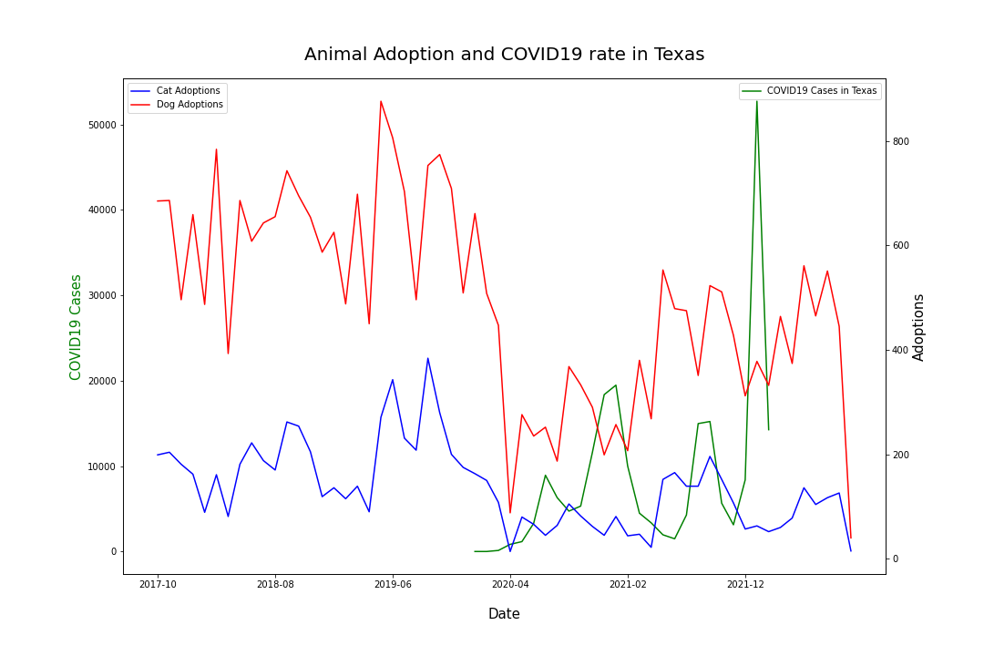
Adoption rates (During)

Slide 8
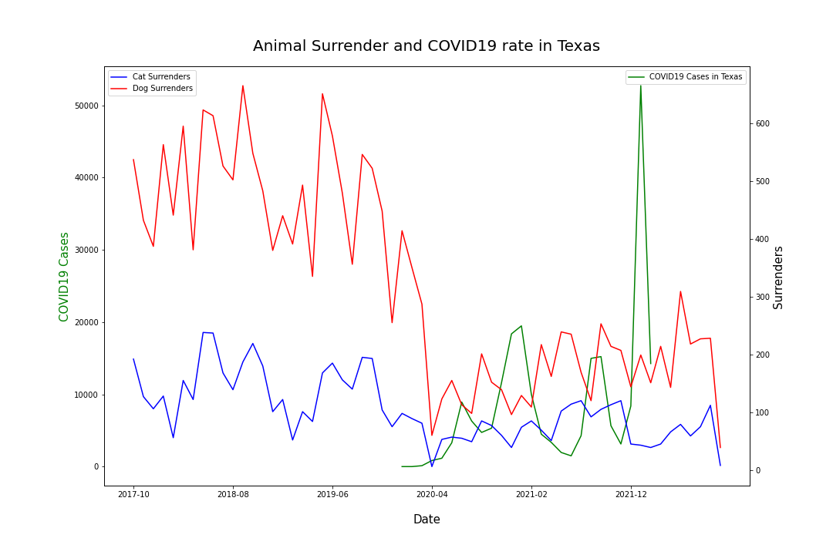
SURRENDER RATES (During)

Slide 9
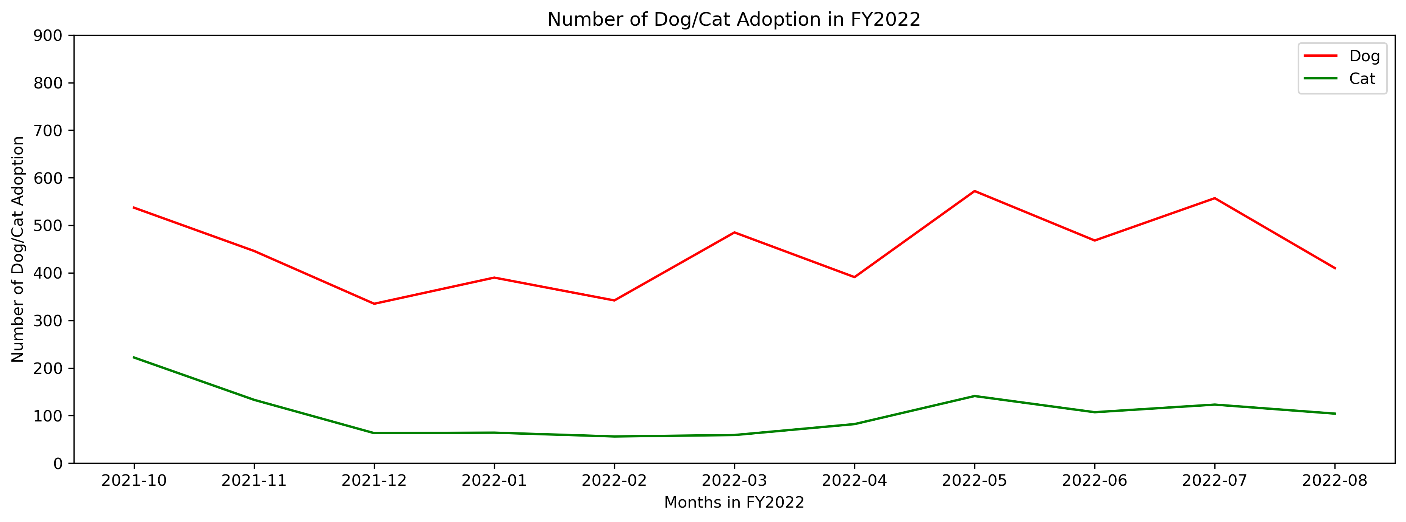
Adoption rates (After)

Slide 10
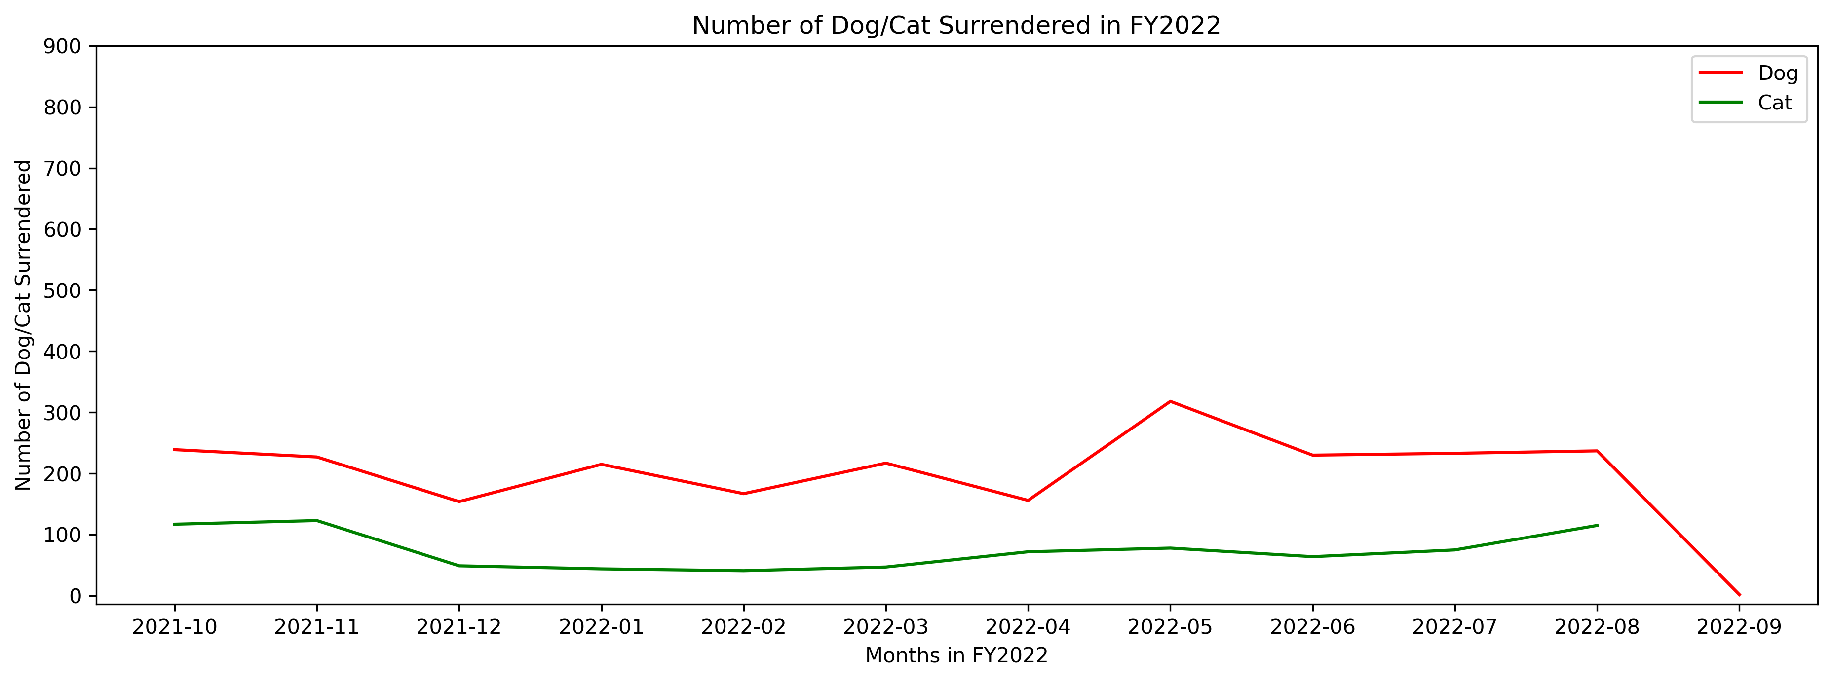
SURRENDER RATES (After)

Slide 11
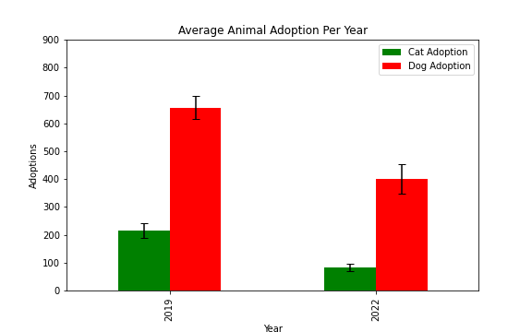
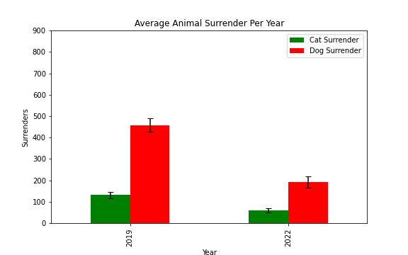
ADOPTION AND SURRENDER 2019 v 2022
***
***
***
***
Data show mean values for each year, two-tailed test was performed between years; *** = P-value < 0.001

Slide 12
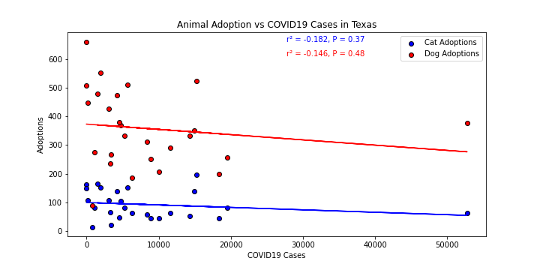
THE RELATIONSHIP BETWEEN: ADOPTION & COVID-19 CASES

Slide 13
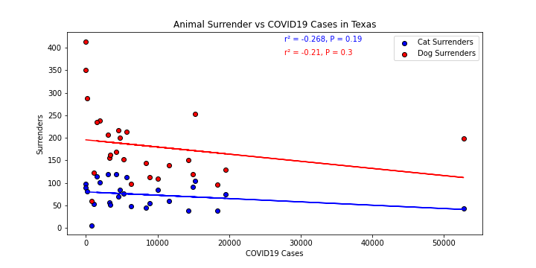
THE RELATIONSHIP BETWEEN: SURRENDER & COVID-19 CASES

Slide 14
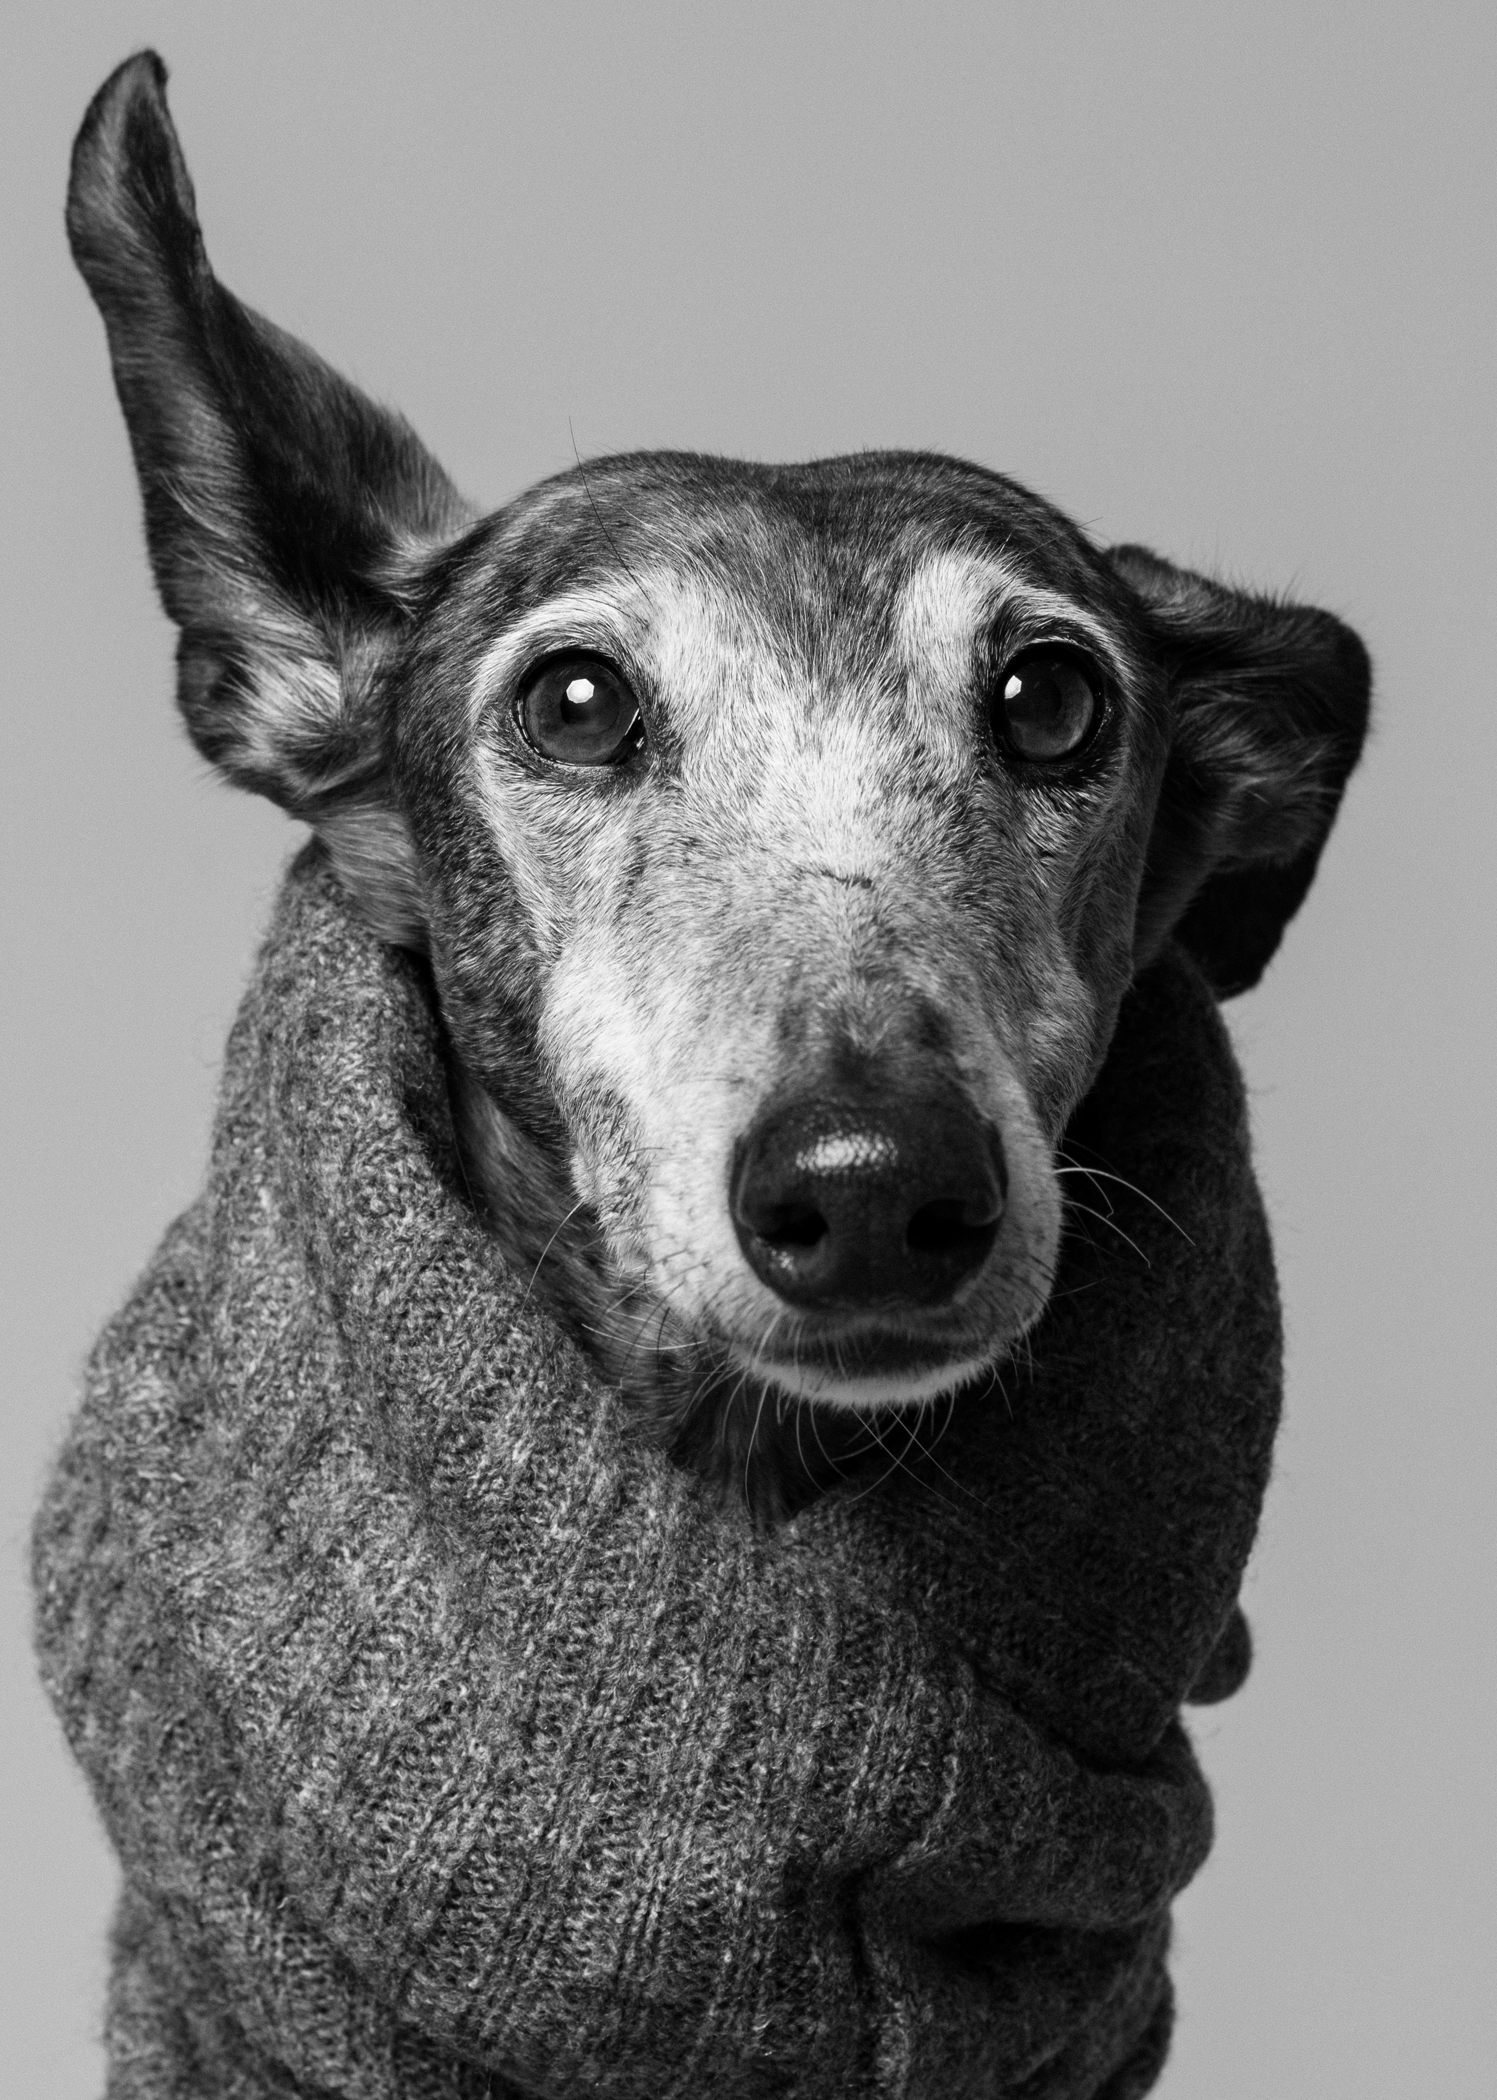
CONCLUSION:
Adoption and surrender rates in Dallas dramatically decreased following the pandemic
There was no correlation between case numbers and adoption/surrender rates
Dogs are a much more popular animal to both adopt and surrender in Dallas than cats.

Slide 15

LIMITATIONS:
This data does not include breeders’ adoption or surrender rates.
This data only includes dog adoption shelters using the Chameleon software.
This data is only for the Dallas area and rates could be different elsewhere.
This data is only for pets that were categorized as adopted or surrender.

Slide 16
Resources
Covid19 Data @ KFF
https://github.com/KFFData/COVID-19-Data
Covid19 Data @ John Hopkins
https://coronavirus.jhu.edu/data/state-timeline/new-confirmed-cases/texas
City of Dallas Animal Services API
https://dallascityhall.com/departments/dallas-animal-services/Pages/Statistical-Reports.aspx

